Slide 1
Geography of Ethanol Production
Unit 2, Lesson 4

Slide 2
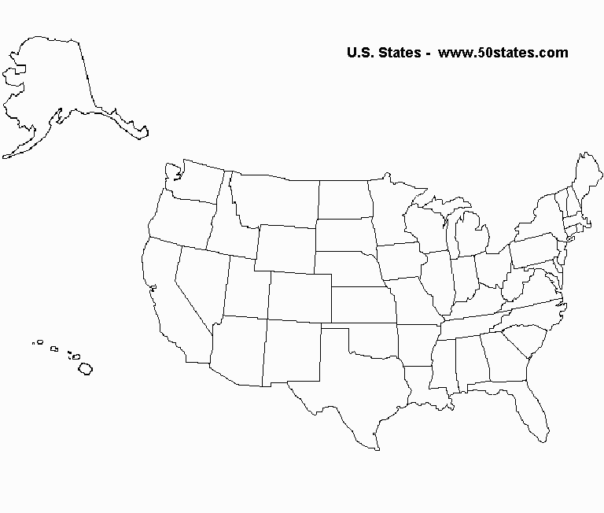
How many biorefineries utilize corn as the primary feedstock?
How many biorefineries process sugar/starch? How many biorefineries process cellulose?
Label each state on the map with the number of biorefineries that are located in that state.
Identify and list some of the other types of feedstocks being used.

Slide 4
Ethanol facilities location determining factors
Current and projected regional markets, including competing gasoline components and prices.
Feedstock availability
Demand and cost
Utilities and related infrastructure (includes waste water treatment options, roads and drinking water quantity and quality)
Transportation options
Pre-existing environmental conditions that may impact the area
Land zoning and cost

Slide 5
Ethanol facilities location determining factors
Weather and prevailing wind patterns
Key economic issues, including eligibility for public finance programs.
Labor availability.
An assessment of co-products and by-products from preferred feed stocks and production processes, and a preliminary assessment of markets for co-products.
Assessment of the approximate economic impact of the proposed plant on the local area is also completed.
Review of a financial model that is applicable to the proposed process.
Review of the business structure options that may be viable for the proposed project.
A review of additional informational and potential financial resources that may be available to project developers.

